Slide 1
Project 1:
Vaccinations and COVID-19 Deaths
by: Sally Anderson, Kenia Oquendo Berrios, Gwendolyn Lukman, and Jackie Rosales

Slide 2
Executive Summary
The subject of our analysis was healthcare. Specifically, COVID-19 and death rates. Our analysis will conclude if external factors influence COVID-19 death rates. The chosen factors for this analysis are: population density and vaccine rates.
Next, data was collected from government sources and cleaned. Time and scope were limiting factors, so many considerations had to be taken with the analysis. Lastly, the results were analyzed and will be presented
Notes:
JACKIE
Exec sum: intro, data, limits, h1, h2, analysis An executive summary or overview of the project and project goals: Explain how the project relates to the industry you selected.

Slide 3
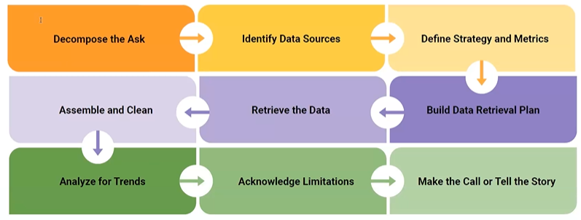
Introduction
Decompose the ask:
Population density is based on total state population
Vaccine rate is based on at least one dose
The field: Healthcare
The subject: COVID-19
The analysis: external factors affecting death rates
Notes:
JACKIE
When decompose the ask
decompose the ask -> what is our question -> pop density affects death nums, vaccine affect death nums

Slide 4
DataSets and Sources
Data.gov : Provisional_COVID-19_Deaths_by_Sex_and_Age.csv https://catalog.data.gov/dataset/provisional-covid-19-death-counts-by-sex-age-and-state
CDC : Covid19_vaccinations_in_us.csv https://covid.cdc.gov/covid-data-tracker/#vaccinations_vacc-people-booster-percent-pop5
Census.gov : NST-EST2022-POPCHG2020_2022.csv (2022 Population by State) https://www2.census.gov/programs-surveys/popest/datasets/2020-2022/state/totals/
Notes:
JACKIE
v2: we chose data from: data gov (bunch of us datasets), the CDC, and the us census

Slide 5
Retrieve and Clean the Data
Define Strategy and Metrics
Group the states by population, combine all individual counties under one state
Data Retrieval Plan
Download publicly available data
Assemble and Clean
Remove non-state entities (DC, Puerto Rico, American Samoa, Virgin Islands)
Remove extra columns (vaccine by brand, doses by age)
Combine the csv files
Notes:
JACKIE

Slide 6
Limitations
Limitations
Only studied the USA, only official states
Only considered death rates, not infection rates
Removed age, gender, and region from the analysis
Only cumulative data used
Notes:
JACKIE

Slide 7
Hypothesis 1
Null Hypothesis 1: The amount of people who died of COVID-19 is NOT affected by the state population.
Alternate Hypothesis 1: The amount of people who died of COVID-19 will be higher in more populated states than in less populated states.
Our prediction is to reject the Null Hypothesis 1.
Logic: If the population is densely concentrated, then death rates will be higher in more populated states because the population will have a higher rate of person-to-person interaction.
Notes:
SALLY
What is the relationship of Covid deaths and state population?

Slide 8
Hypothesis 2
Null Hypothesis 2: Vaccination does NOT contribute to a decrease in the likelihood of death from COVID-19.
Alternate Hypothesis 2: Vaccination contributes to a decrease in the likelihood of death from COVID-19.
Our prediction is to reject the Null Hypothesis 2.
Logic: If a person is vaccinated, then they are less likely to die from COVID-19.
Notes:
SALLY
What is the relationship of vaccination and Covid deaths?

Slide 9
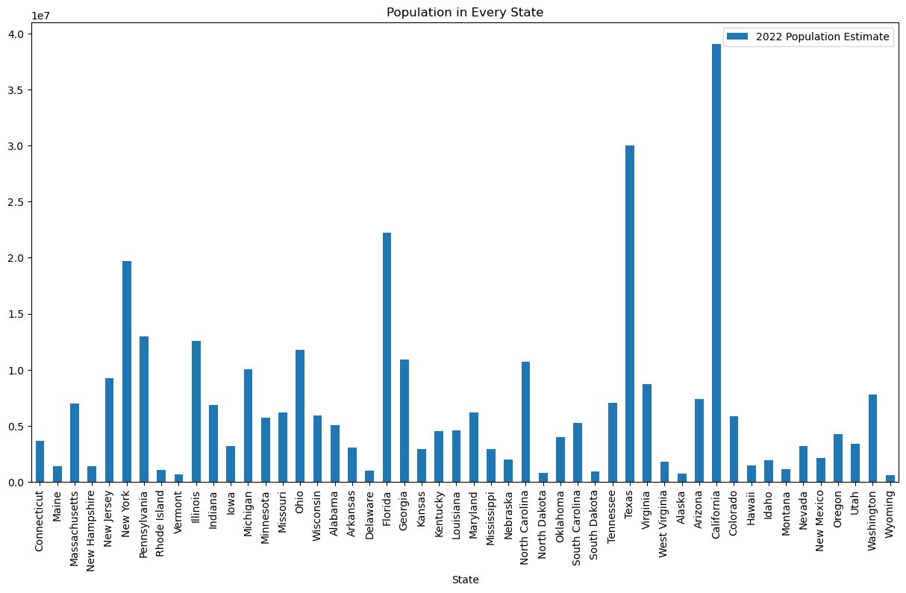
Visual Representation of Population per State
Notes:
Gwen
Population is not consistent, which led us to separate with quartiles
From the data we got from census.gov we made it into a bar chart to visualize the data, this data represents the population estimation of states in the year 2022
As you can see there are states with really high population like california and texas while other states like vermont, maine, delaware with really small population.
There is a lot of variance with the population data in each state

Slide 10
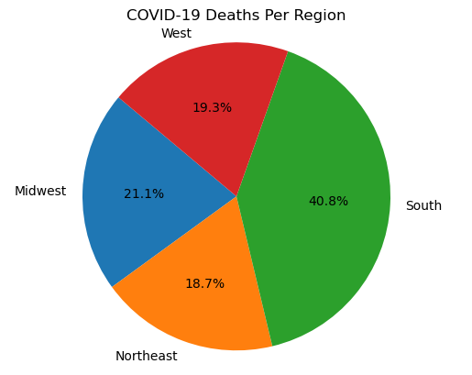
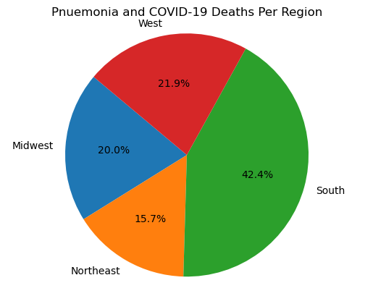
Deaths Per Region = Skewed Data!
Notes:
KENIA

Slide 11
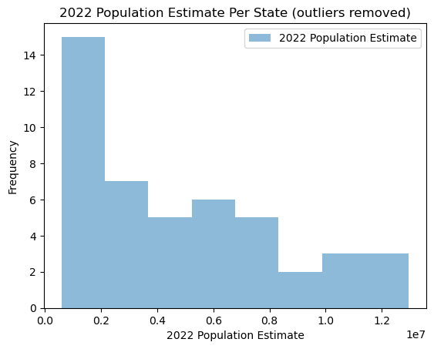
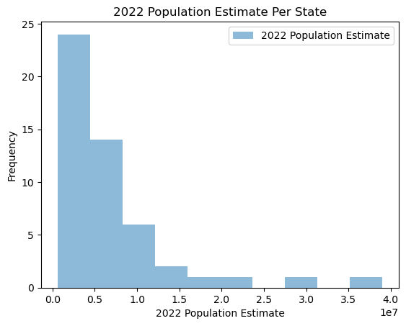
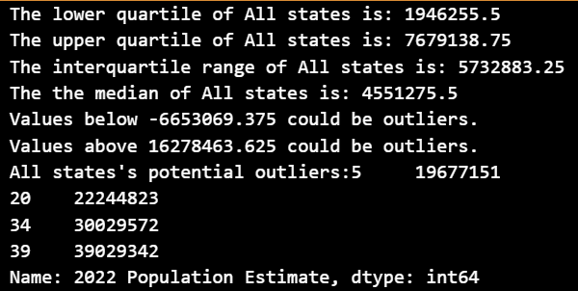
State Population Have Extreme Variance
5 (New York) = 19,677,151
20 (Florida) = 22,244,823
34 (Texas) = 30,029,572
39 (California) = 39,029,342
The population variance:
54,407,169,506,007
(+54 trillion!)
The population standard deviation:
7,376,121
(+7 million)
The population variance:
54,407,169,506,007
(+54 trillion!)
The population standard deviation:
7,376,121
(+7 million)
The population variance: 12,131,875,053,153
(12+ trillion… much better)
The population standard deviation:
3,483,084
Notes:
Kenia

Slide 12
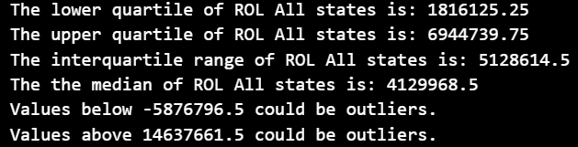
Quartiles to determine Thresholds
Quartiles |  | Amount | Population Threshold | States
Outliers |  | Extremely High | >= 19,677,151 | NY, FL, TX, CA
Quartiles |  | Amount | Population Threshold | States
Q3 | 75% of data | Higher | < 19,677,151 & > 6,944,739 | MA, NJ, PA, IL, MI, OH, GA, NC, TN, VA, AZ, WA
Q2 | 50% of data | Medium | < 6,944,739 & > 1,816,125 | CT, IN, IA, MN, MO, WI, AL, AR, KS, KY, LA, MD, MS, NE, OK, SC, CO, ID, NV, NM, OR, UT
Q1 | 25% of data | Lower | < 1,816,125 | ME, NH, RI, VT, DE, ND, SD, WV, AK, HI, MT, WY
Notes:
Kenia

Slide 13
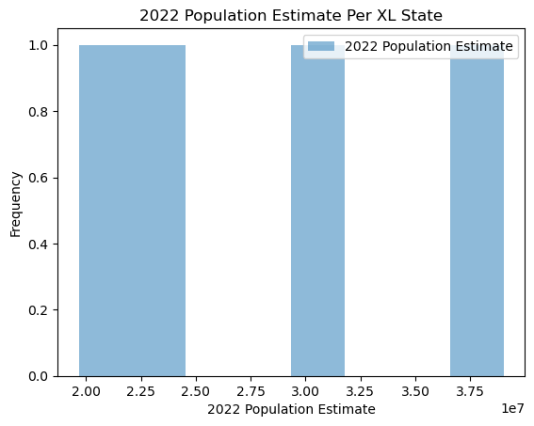
XL States (Outliers) Histogram
New dataframe for XL States only (NY/CA/TX/FL) - only 4 states (small sample size)
Outlier states total population is 33% of the United States total population
Variance | Standard deviation
56,974,444,479,285 | 7,548,141
Notes:
Kenia

Slide 14
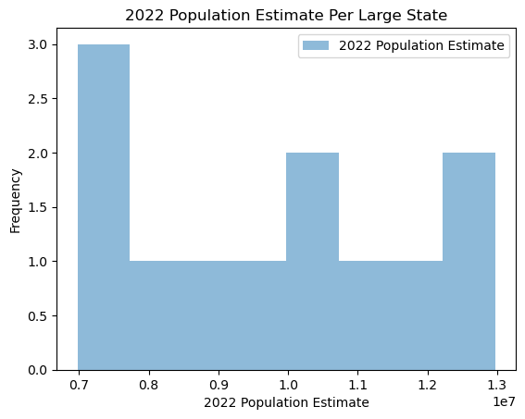
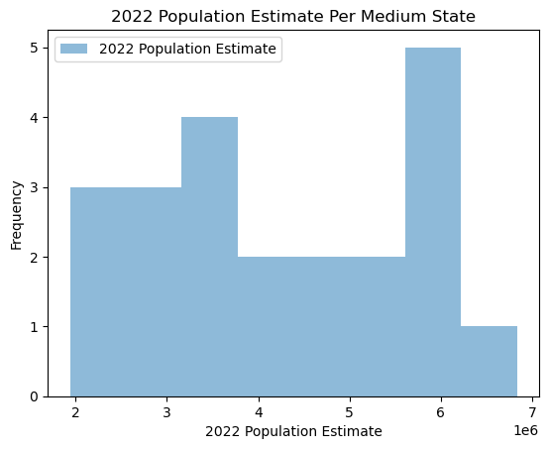
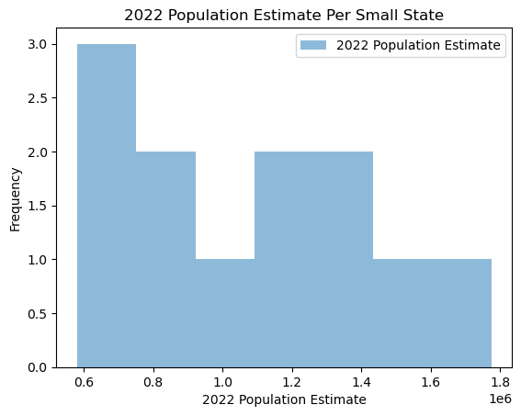
Large, Medium, and Small State Histograms
Large states total population is 35% of the United States total population
Medium states total population is 28% of the United States total population
Small states total population is 4% of the United States total population
Variance | Standard deviation
4,215,283,147,536 | 2,053,115
Variance | Standard deviation
2,126,604,782,650 | 1,458,288
Variance | Standard deviation
123,863,654,010 | 351,942
Notes:
Kenia

Slide 15
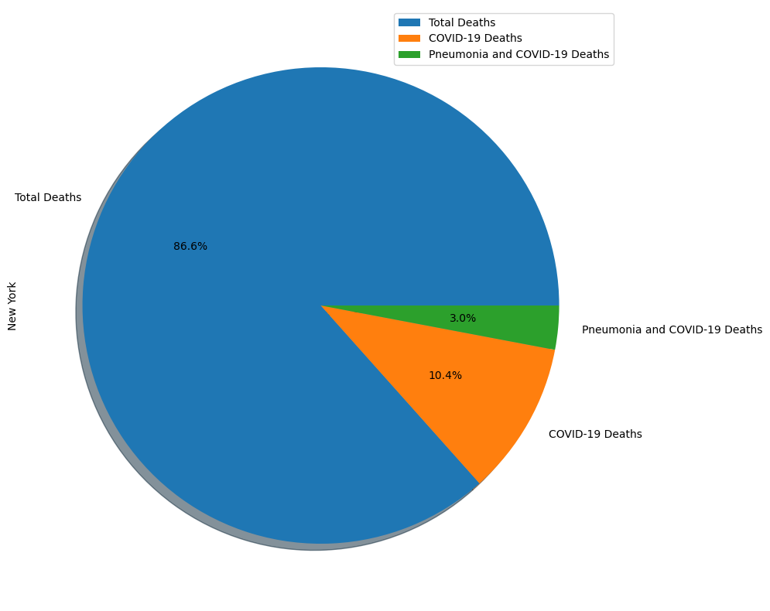

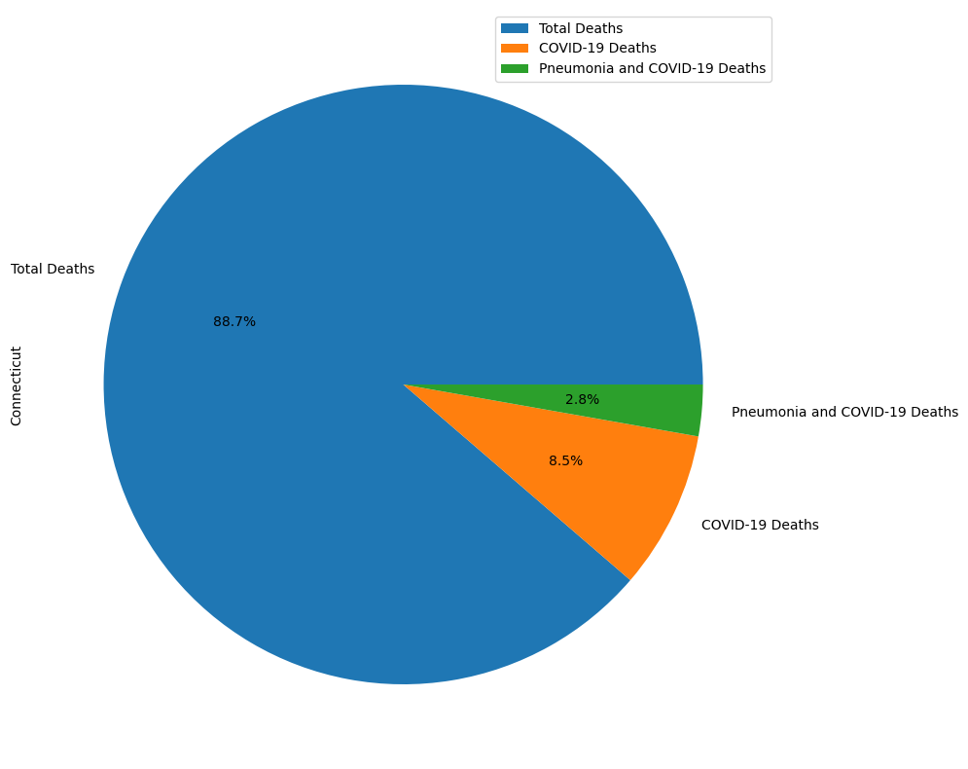
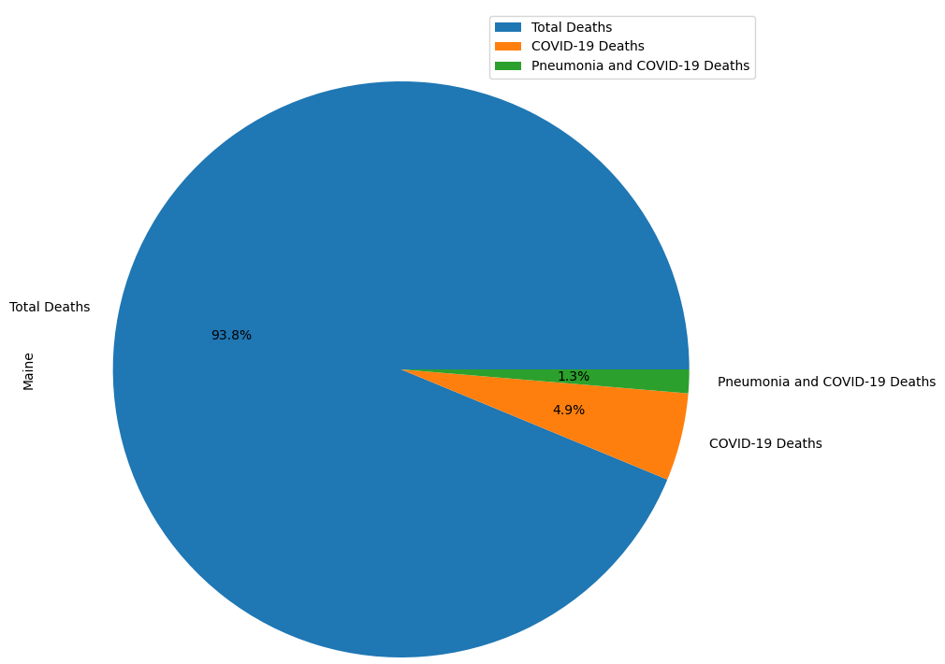
Death Comparisons
XL STATES
LG STATES
Total deaths=
ALL deaths
XL states: ~10%:
Lg & Md states: ~7% to ~9%
Sm states: ~5%
3
3
%
35%
MD STATES
SM STATES
2
8
%
4
%
Notes:
Kenia

Slide 16
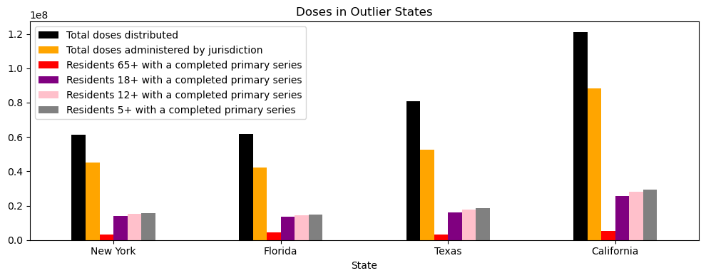
XL States with completed primary series
Notes:
Gwen
After separating the state
This slide shows the XL state which is the outlier states that populaties 33% of the US
This chart shows the our vaccination data of total doses distributed, total doses administered and the different age groups that completed the primary series that is differentiated by colors.
surprisingly : +65 people have the least completed series and ages 5+ has the most completed series
These groups might have a biggest primary series completion because schools make it mandatory for vaccinations
Explain what the colors represent,
Outlier states (33% of US)
What we realize is that the range of ages stop at the next group of people (so for examples Residents 5+ is basically kids from ages 5 to 11

Slide 17
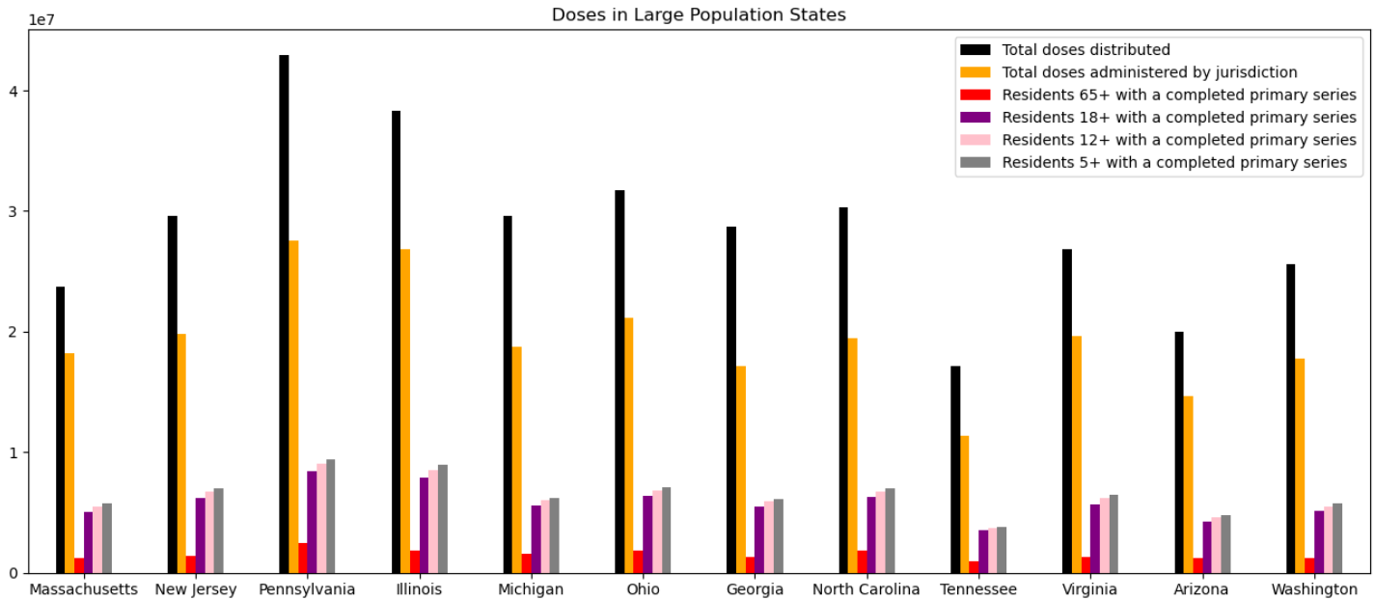
Large States with completed primary series
Notes:
Gwen
This slide shows the population of the large states, the total population of these states are 32% of the us. We can also see that people with the age of 65+ have the least vaccination
large (32% of states) (Q3)

Slide 18
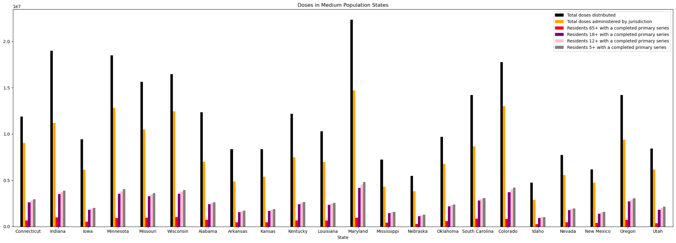
Medium States with completed primary series
Notes:
Gwen
These are the medium states that populate around 28% of the US (Q2)
They have the most states
We here can see the same patterns as the previous analysis (young people have the most completed series)

Slide 19
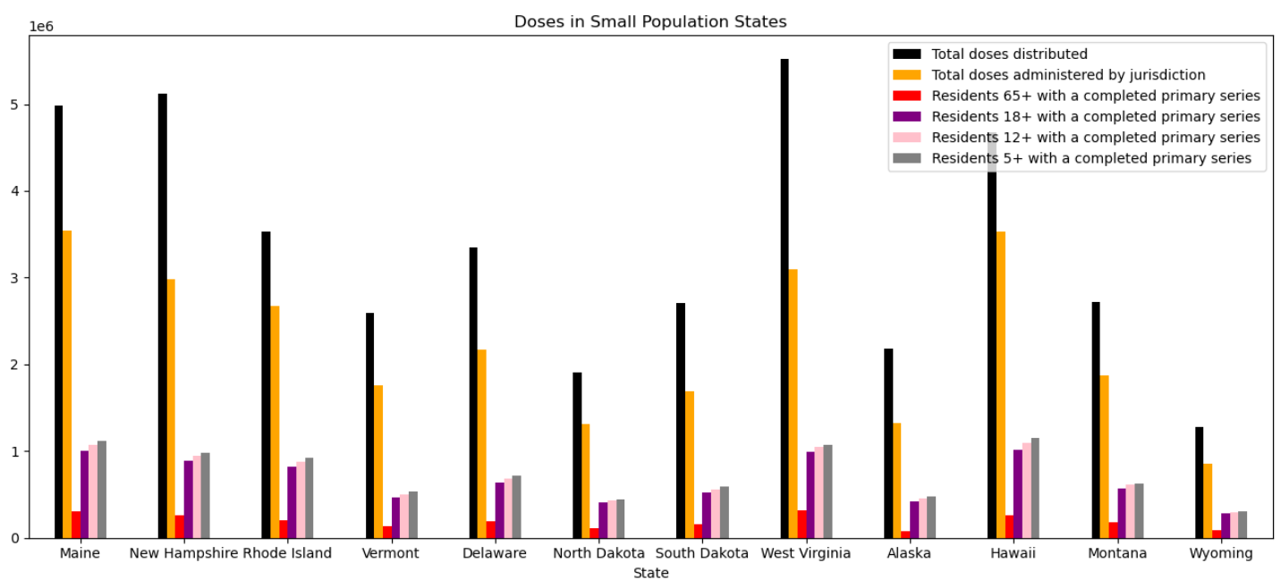
Small States with completed primary series
Notes:
Gwen
Last but not least the small states populate around 4% of the US(Q1)
Again we see the same patterns thus we can conclude that they have a consistent pattern of old people having the least completed series and young people having the most

Slide 20
How many people were vaccinated per state?
Trends:
All states did not administer all doses that were distributed from the US government
65+ demographic had the lowest vaccination rates out of all the groups tested.
We predicted this would be the highest because they were considered the highest risk group for death.
We are unsure about why this was the case since each state targeted this demographic heavily
All states followed the same trend in vaccination totals: 5+ > 12+ > 18+ > 65+
Possible explanation:
School age children (5+ & 12+ groups) were required to be vaccinated before going back to school
18+ group were wanting to get back to regular life faster (and possibly less fearful of adverse effects from the vaccine)
18+ group may have been required by their workplace to be vaccinated before returning to work in person
Notes:
Sally

Slide 21
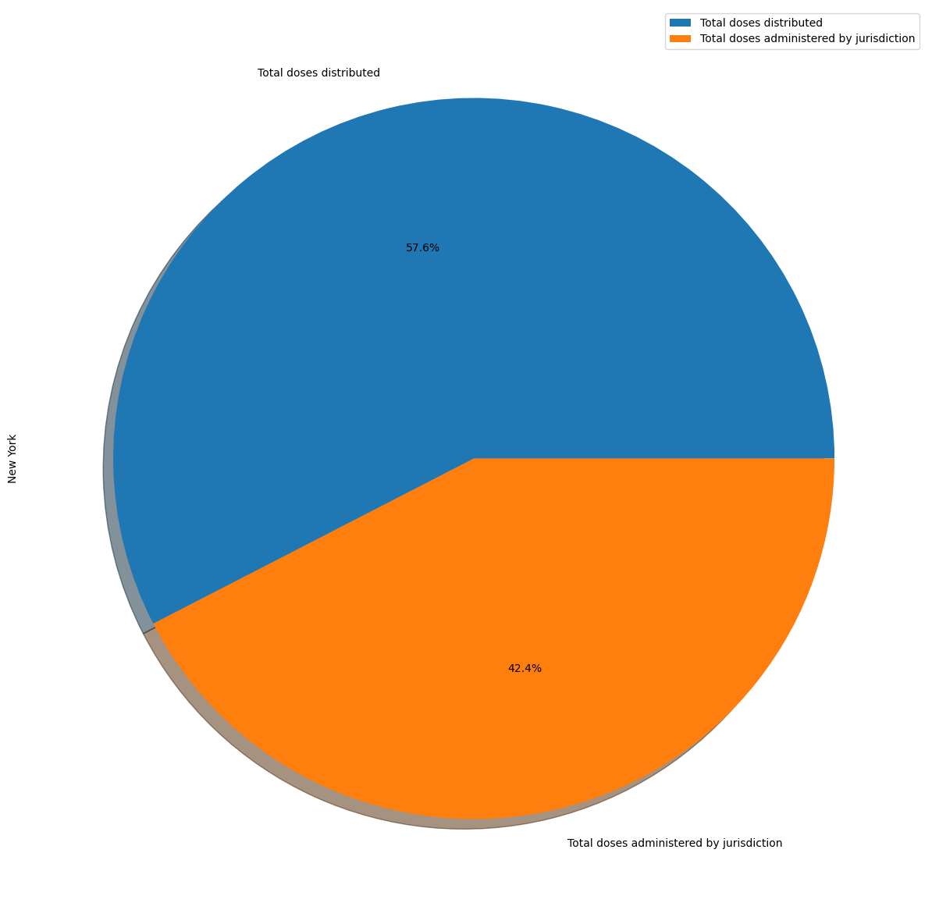
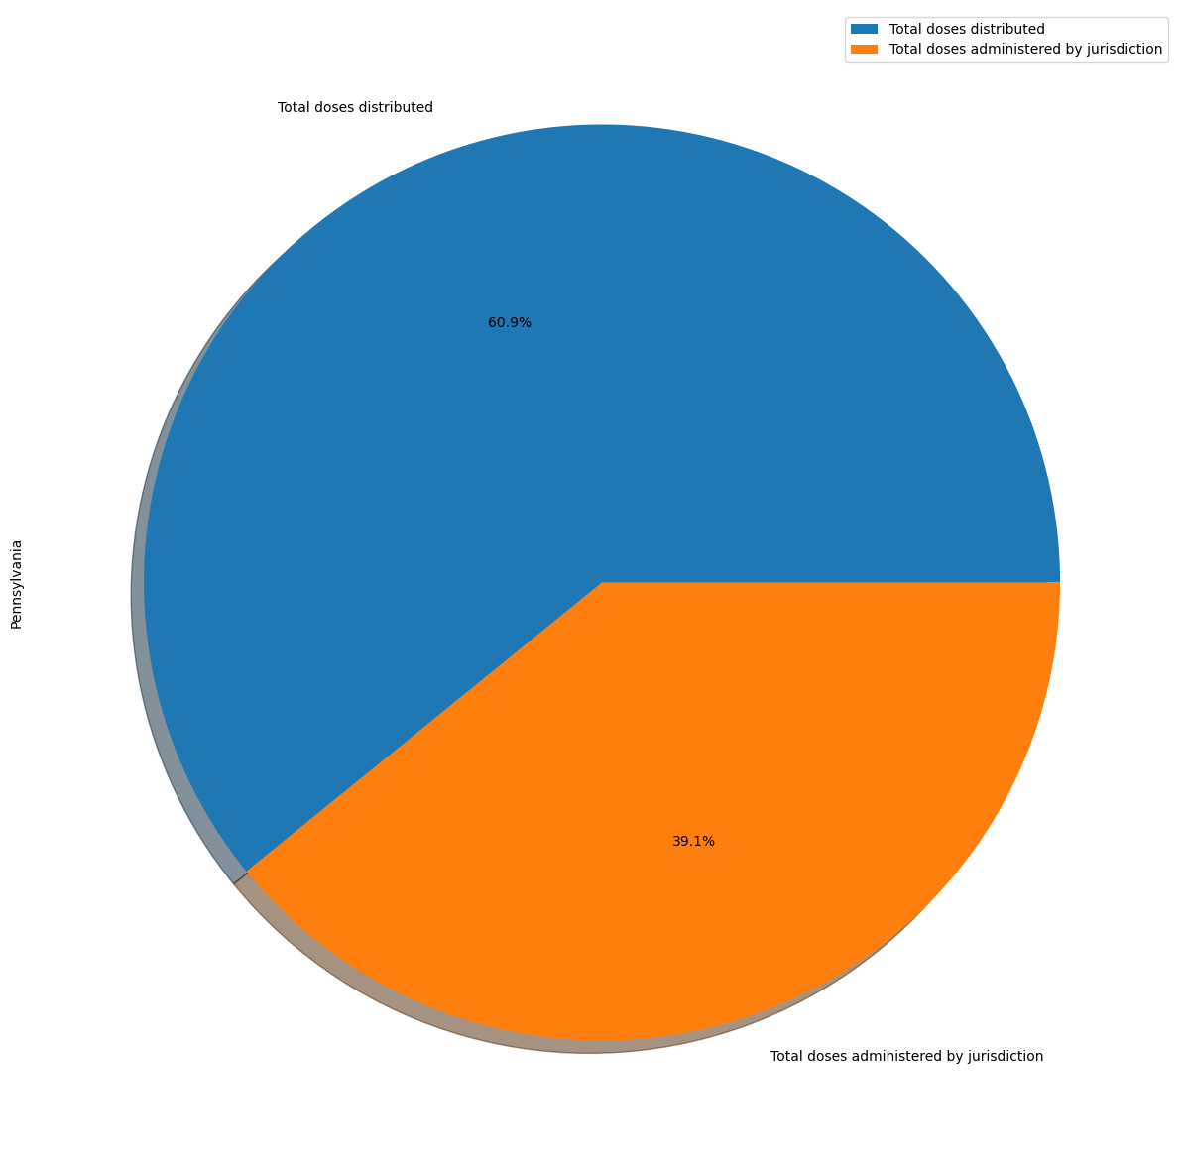
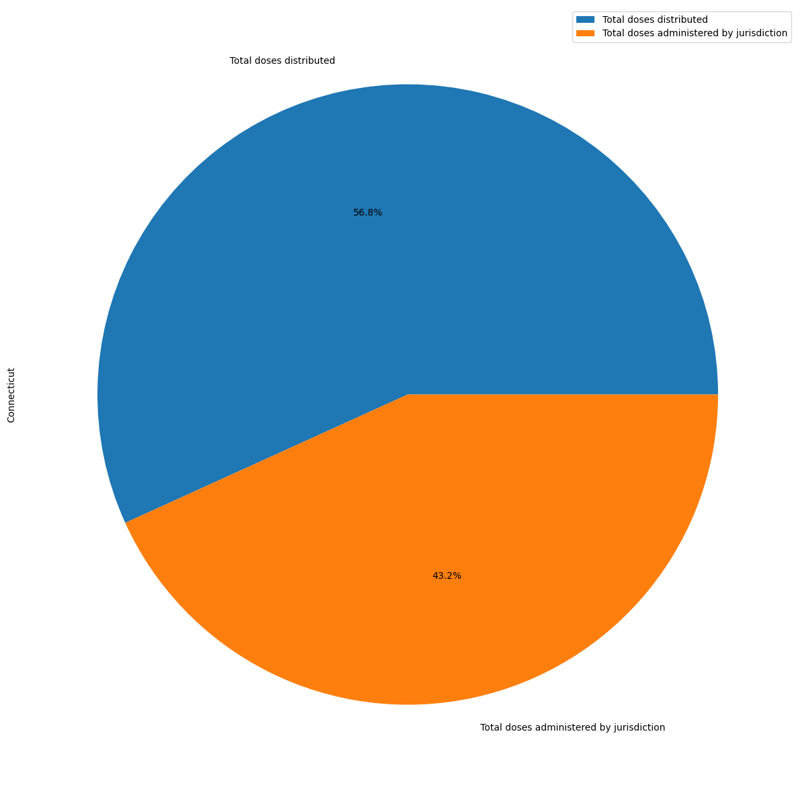
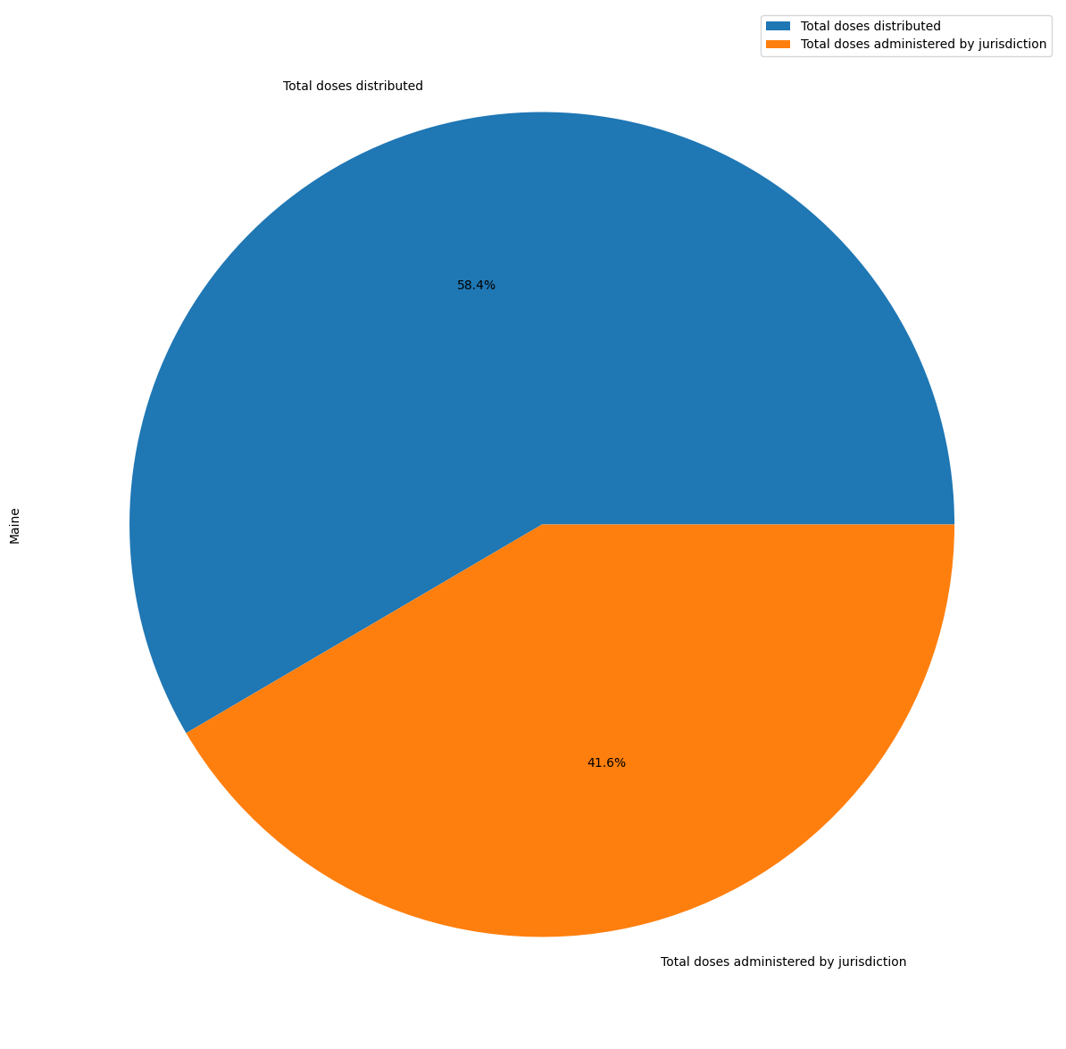
Distributed Vaccines vs Administered Vaccines
This should not allude that the administered % is equivalent to the total vaccination percentage rate
XL STATES
LG STATES
MD STATES
SM STATES
Notes:
Kenia
Quantity of doses that were used
57.6% is not administered in NY

Slide 22
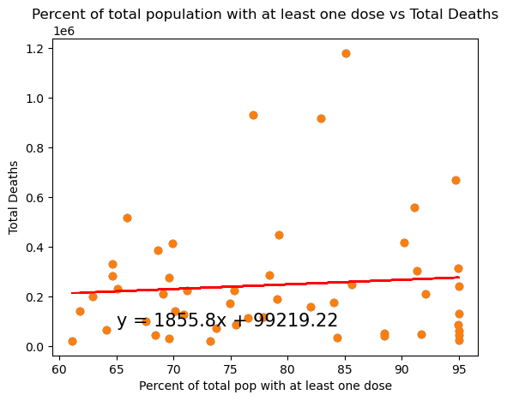
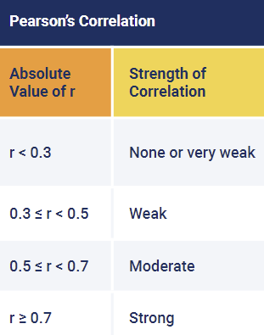
What is the correlation between of the vaccination vs total deaths?
The r-squared is: 0.006929896302602268
There is no or very weak correlation between vaccination and death.
Notes:
Sally

Slide 23
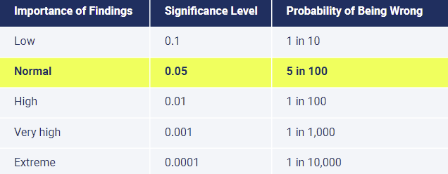
H1: Hypothesis 1 Testing
Used independent t-tests for hypothesis testing
Data tested within dataframe -
“2022 Population Estimate” vs “COVID-19 Deaths”
All p-values are below p = 0.05
Population vs COVID-19 Death | p-value
All states | 0.00000008308
XL | 0.00791821963
L | 0.00000000768
M | 0.00000000001
S | 0.00000067855
Conclusion
We REJECT: Null Hypothesis 1
The amount of people who died of COVID-19 is NOT affected by the state population.
We CANNOT REJECT: Alternate Hypothesis 1
The amount of people who died of COVID-19 will be higher in more populated states than in less populated states.
Notes:
Sally

Slide 24
H2: Hypothesis 2 Testing
Used independent t-tests for hypothesis testing
Data tested within dataframe -
“Residents with at least one dose” vs
“COVID-19 Deaths”
All p-values are below p = 0.05
Vaccination vs COVID-19 Death | p-value
All states | 0.00000025333
XL | 0.00820147030
L | 0.00000002761
M | 0.00000000004
S | 0.00000223341
Conclusion
We REJECT: Null Hypothesis 2
Vaccination does NOT contribute to a decrease in the likelihood of death from COVID-19.
We CANNOT REJECT: Alternate Hypothesis 2
Vaccination contributes to a decrease in the likelihood of death from COVID-19.
Notes:
Sally

Slide 25
Summary of Findings
Question 1: What is the relationship between the amount of people who died of COVID-19 and the state population? Based on the data, we CANNOT REJECT the alternative hypothesis that says: The amount of people who died of COVID-19 will be higher in more populated states than in less populated states.
Question 2: What is the relationship between vaccination and its ability to protect from COVID-19 death?
Based on the data, we CANNOT REJECT the alternative hypothesis that says: Vaccination contributes to a decrease in the likelihood of death from COVID-19.
Limitations: limited to USA, only cumulative data (year 2020 - 2023), population data is only from latest 2022 Census data (does not account for population changes in 2023) In the future, include data such as gender, age, or analyze the datasets through time (years, months)
Notes:
Jackie
large states = 39029342 to 22244823
medium states = 22244823 to 4129968
small = < 4129968

